Slide 1

The link between your ears and your mind
Practice name

Slide 2

The link between your ears and your mind
Practice name

Slide 3
Today we’ll discuss
Welcome & Introductions
The ears and the brain are equal partners
Hearing Facts & Figures
The influence of hearing aids on cognition
Notes:
Welcome: Here is what we’ll review in the short time we have together.
I’ll tell you a little more about me and my practice, review how we hear, and then review current scientific developments that explore the link between hearing and our brains and cognition.

Slide 4
Welcome
Introduce yourself to your audience
Include a short bio
Education
Years in practice
About your practice
Personal information such as hobbies and interests
And add picture(s) of yourself, your staff, family

Slide 5
How you hear
Notes:
To get us started, I’d like to take a few minutes to watch a short video that describes how we hear.

Slide 6
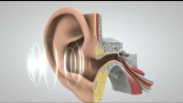
Notes:
https://youtu.be/eQEaiZ2j9oc
Video is 2:27 long and you need internet to play the video.
Segue from the end of the video where the brain understands to how the brain and the ears are equal partners.

Slide 7
The ears and the brain are equal partners
Notes:
It’s not just your ears doing the work of hearing, listening and understanding, but it’s also your brain. And your ears and your brain are linked together.

Slide 8

The ears pick up
sounds
The brain comprehends
The better quality of the incoming signal the better chance for comprehension¹⁻²
1.Kiessling, J., Pichora-Fuller, M. K., Gatehouse, S., Stephens, D., Arlinger, S., Chisolm, T., . . . von Wedel, H. (2003). Candidature for and delivery of audiological services: special needs of older people. International Journal of Audiology, 42 Suppl 2, 2S92-101.
2.Pichora-Fuller, M. K. (2008). Audition and cognition: Where lab meets clinic. The ASHA Leader, 13(10), 14-17.
Notes:
Let’s talk about what I mean about the ears and the brain being equal partners.
Animations:
1, [CLICK] Just as we saw in the video, your ears pick up the acoustic signals (AKA sounds in your world)
2. The ear then decodes the information so it can travel to the brain and
the brain puts the sound puzzle together in a way that makes sense to the brain. (Have you misunderstood someone because of this problem here?)
Of course, The better the quality of the incoming signal, the better the chances for speech comprehension.¹⁻²
The better the cognitive resources, the better they can potentially compensate for missing information or hearing loss.
Now, let’s talk about who experiences difficulties hearing.
References:
Kiessling, J., Pichora-Fuller, M. K., Gatehouse, S., Stephens, D., Arlinger, S., Chisolm, T., . . . von Wedel, H. (2003). Candidature for and delivery of audiological services: special needs of older people. International Journal of Audiology, 42 Suppl 2, 2S92-101.
2. Pichora-Fuller, M. K. (2008). Audition and cognition: Where lab meets clinic. The ASHA Leader, 13(10), 14-17.

Slide 9

Hearing Facts and Figures
65%
of adults over 60 have hearing loss²
15%
of US adults (18+) report some trouble hearing¹
1. NIH Pub. No. 23-DC-4235. February 2023, https://www.nidcd.nih.gov/health/age-related-hearing-loss#:~:text=It%20is%20one%20of%20the,than%2075%20have%20difficulty%20hearing., Retrieved 12/27/2023
2. World Health Organization. (2021). World report on hearing. Geneva: World Health Organization. Retrieved from https://www.who.int/publications/i/item/world-report-on-hearing
Notes:
According to the Global Burden of Disease Study, age-related hearing loss is ranked as the 5th leading cause of disability across ages.¹ The other 4 are low back pain, headache disorders, depressive disorders and diabetes.
And as we know, the older population is more at risk. Currently, 65% of adults over age 60 have hearing loss.²
References:
Institute for Health Metrics and Evaluation (IHME). (2018). Findings from the Global Burden of Disease Study 2017. Seattle, WA: IHME. http://www.healthdata.org/sites/default/files/files/policy_report/2019/GBD_2017_Booklet.pdf
World Health Organization. (2021). World report on hearing. Geneva: World Health Organization. Retrieved from https://www.who.int/publications/i/item/world-report-on-hearing
MORE STATS BELOW:
Quick Statistics About Hearing from NIH; retrieved on 12/21/23.
About 2 to 3 out of every 1,000 children in the United States are born with a detectable level of hearing loss in one or both ears.¹
More than 90 percent of deaf children are born to hearing parents.²
Approximately 15% of American adults (37.5 million) aged 18 and over report some trouble hearing.³
Age is the strongest predictor of hearing loss among adults aged 20-69, with the greatest amount of hearing loss in the 60 to 69 age group.⁴
Men are almost twice as likely as women to have hearing loss among adults aged 20-69.⁴
One in eight people in the United States (13 percent, or 30 million) aged 12 years or older has hearing loss in both ears, based on standard hearing examinations.⁵
About 2 percent of adults aged 45 to 54 have disabling hearing loss. The rate increases to 8.5 percent for adults aged 55 to 64. Nearly 25 percent of those aged 65 to 74 and 50 percent of those who are 75 and older have disabling hearing loss.⁶
Roughly 10 percent of the U.S. adult population, or about 25 million Americans, has experienced tinnitus lasting at least five minutes in the past year.⁷
About 28.8 million U.S. adults could benefit from using hearing aids.⁸
Among adults aged 70 and older with hearing loss who could benefit from hearing aids, fewer than one in three (30 percent) has ever used them. Even fewer adults aged 20 to 69 (approximately 16 percent) who could benefit from wearing hearing aids have ever used them.⁹
As of December 2019, approximately 736,900 cochlear implants have been implanted worldwide. In the United States, roughly 118,100 devices have been implanted in adults and 65,000 in children.¹⁰
Five out of 6 children experience ear infection (otitis media) by the time they are 3 years old.¹¹
Sources:
Centers for Disease Control and Prevention (CDC). Identifying infants with hearing loss - United States, 1999-2007. MMWR Morb Mortal Wkly Rep. 59(8): 220-223.
Vohr B. Overview: infants and children with hearing loss—part I. Ment Retard Dev Disabil Res Rev. 2003;9:62–64.
Mitchell RE, Karchmer MA. Chasing the mythical ten percent: Parental hearing status of deaf and hard of hearing students in the United States. (PDF) Sign Language Studies. 2004;4(2):138-163.
Blackwell DL, Lucas JW, Clarke TC. Summary health statistics for U.S. adults: National Health Interview Survey, 2012 (PDF). National Center for Health Statistics. Vital Health Stat 10(260). 2014.
Hoffman HJ, Dobie RA, Losonczy KG, Themann CL, Flamme GA. Declining Prevalence of Hearing Loss in US Adults Aged 20 to 69 Years. JAMA Otolaryngology – Head & Neck Surgery. December 2016 online.
Lin FR, Niparko JK, Ferrucci L. Hearing loss prevalence in the United States. [Letter] Arch Intern Med. 2011 Nov 14; 171(20): 1851-1852.
Based on calculations performed by NIDCD Epidemiology and Statistics Program staff: (1) using data from the 1999-2010 National Health and Nutrition Examination Survey (NHANES); (2) applying the definition of disabling hearing loss used by the 2010 Global Burden of Disease Expert Hearing Loss Team (hearing loss of 35 decibels or more in the better ear, the level at which adults could generally benefit from hearing aids).
Based on calculations performed by NIDCD Epidemiology and Statistics Program staff: (1) tinnitus prevalence was obtained from the 2008 National Health Interview Survey (NHIS); (2) the estimated number of American adults reporting tinnitus was calculated by multiplying the prevalence of tinnitus by the 2013 U.S. Census population estimate for the number of adults (18+ years of age).
NIDCD Epidemiology and Statistics Program, based on December 2015 Census Bureau estimates of the noninstitutionalized U.S. population, personal communication; May 2016.
Based on calculations by NIDCD Epidemiology and Statistics Program staff using data collected by (1) the National Health Interview Survey (NHIS) annually for number of persons who have ever used a hearing aid [numerator], and (2) periodic NHANES hearing exams for representative samples of the U.S. adult and older adult population [denominator]; these statisticis are also used for tracking Healthy People 2010 and 2020 objectives. See also Use of Hearing Aids by Adults with Hearing Loss (chart).
Estimates based on manufacturers’ voluntary reports of registered devices to the U.S. Food and Drug Administration, December 2019.
Teele DW, Klein JO, Rosner B. Epidemiology of otitis media during the first seven years of life in children in greater Boston: a prospective, cohort study. J Infect Dis. 1989 Jul;160(1):83-94.

Slide 10

Tinnitus Facts and Figures
80%
of adults with tinnitus have hearing loss²
10-15%
of adults experience tinnitus¹
1. Langguth, B., Kreuzer, P. M., Kleinjung, T., & De Ridder, D. (2013). Tinnitus: causes and clinical management. The Lancet. Neurology, 12(9), 920–930. https://doi.org/10.1016/S1474-4422(13)70160-1
2. Henry, J. A., Dennis, K. C., & Schechter, M. A. (2005). General review of tinnitus: prevalence, mechanisms, effects, and management. Journal of speech, language, and hearing research : JSLHR, 48(5), 1204–1235. https://doi.org/10.1044/1092-4388(2005/084)
Notes:
Optional information regarding tinnitus

Slide 11

Hearing loss doesn’t affect just one person
98%
of spouses
were affected by their partner’s hearing loss
Scarinci, N., Worrall, L., & Hickson, L. (2012). Factors associated with third-party disability in spouses of older people with hearing impairment. Ear and Hearing, 33(6), 698–708. https://doi.org/10.1097/AUD.0b013e31825aab39.
Notes:
Hearing loss doesn’t just affect the person with hearing loss. It can also affect the well-being of family, friends, co-workers, and anyone you spend time with.
In fact, hearing loss is associated with what’s called a “third party disability.” Third party disability is “the disability and functioning of family members as a result of the health condition of their significant other.” A 2012 study found that 98% of spouses were affected by their partners hearing loss in some way.
Segue: Hearing loss can affect your ears, hearing loss can affect your communication partners and hearing loss can affect the brain, and that’s what’s bringing us all together today.
Scarinci, N., Worrall, L., & Hickson, L. (2012). Factors associated with third-party disability in spouses of older people with hearing impairment. Ear and Hearing, 33(6), 698–708. https://doi.org/10.1097/AUD.0b013e31825aab39.

Slide 12

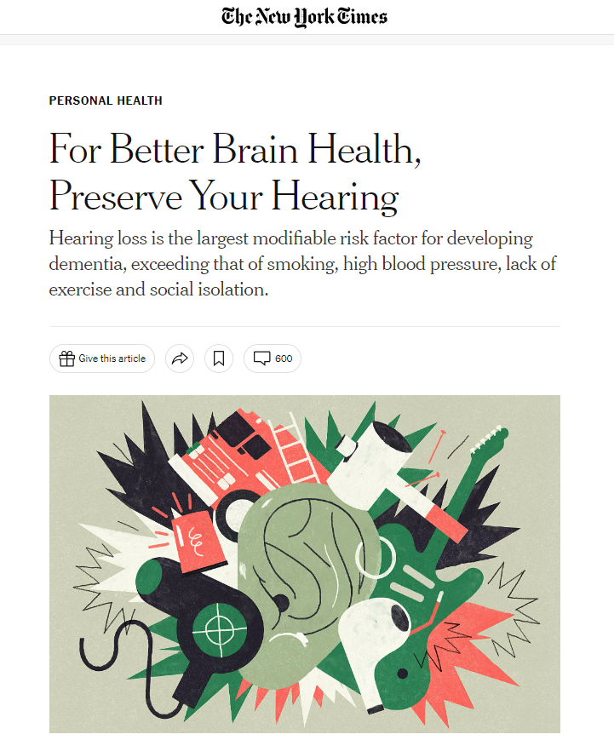

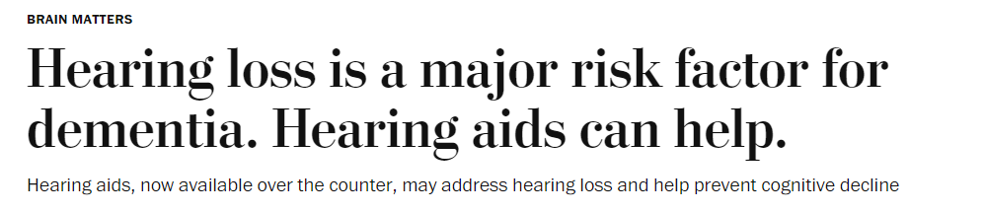

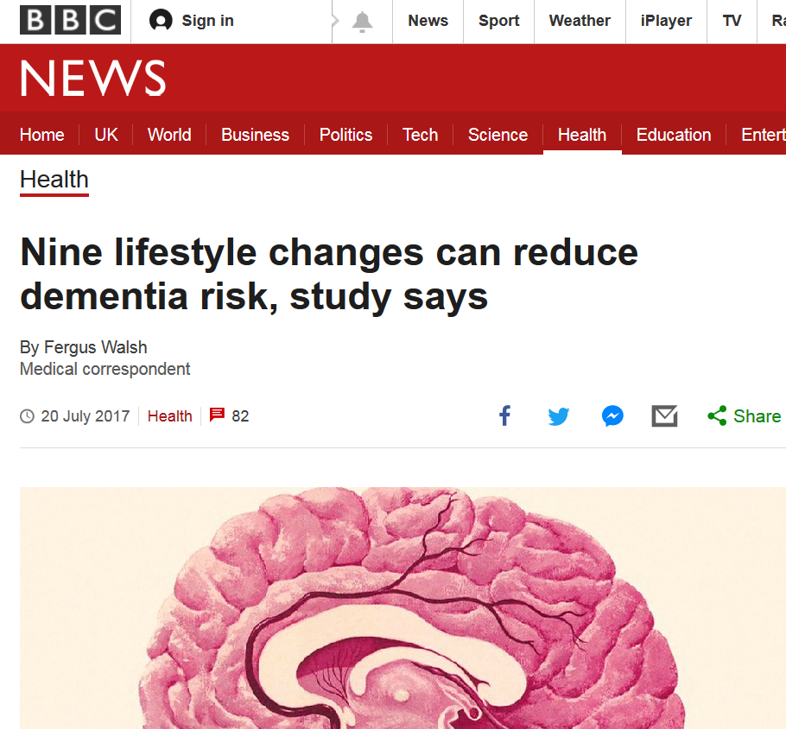
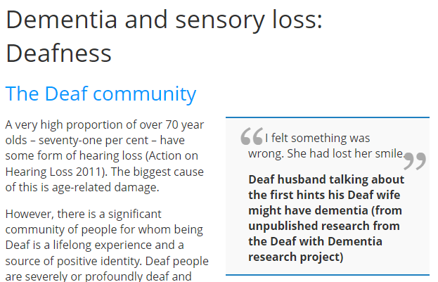



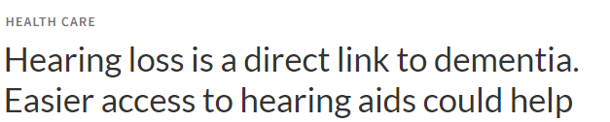
Hearing loss and cognition is getting lots of press
Notes:
Have you seen some of the recent articles linking hearing and cognition/brain health/dementia?

Slide 13

Cognitive changes associated with typical aging
Reduced speed of information processing
Reduced capacity of working memory
Greater effort required for learning new information
Difficulties dividing or switching attention
Notes:
Individuals vary greatly in the extent, rate, and pattern of age-related cognitive changes experienced (Park et al., 2002; Wu et al., 2020).
Cognitive aging (which is normal aging) involves slow cognitive changes which typically span over decades.
Typical cognitive changes include:
Reduced speed of information processing (have you ever asked “what?” only to find you actually heard what was being said?)
Reduced capacity of working memory.
Greater effort required for learning new information. (have you asked a child/grandchild/friend/younger person to help you set up your smartphone/remote control/tv/dvd player?)
Difficulties dividing or switching attention when processing parallel or interfering information (not being able to hear 2 things/conversations at once anymore)
Park, D. C., Lautenschlager, G., Hedden, T., Davidson, N. S., Smith, A. D., & Smith, P. K. (2002). Models of visuospatial and verbal memory across the adult life span. Psychology and Aging, 17(2), 299. doi: https://doi.org/10.1037/0882-7974.17.2.299
Wu, Z., Phyo, A., Al-Harbi, T., Woods, R., & Ryan, J. (2020). Distinct cognitive trajectories in late life and associated predictors and outcomes: a systematic review. Journal of Alzheimer's Disease Reports, 4(1), 459-478. doi: DOI: 10.3233/ADR-200232

Slide 14
Hearing health and cognitive health
Risk of dementia with untreated hearing loss¹
5x
3x
2x
Normal
hearing
Mild
hearing loss
Moderate
hearing loss
Severe
hearing loss
Lin, F. R., Metter, E. J., O’Brien, R. J., Resnick, S. M., Zonderman, A. B., & Ferrucci, L. (2011). Hearing loss and incident dementia. Archives of neurology, 68(2), 214-220.
15/05/2025
Notes:
More rapid and significant cognitive decline can be caused by disease like dementia. Much time and research is focused on the association between hearing health and cognitive health.
In 2011, Dr. Frank Lin from Johns Hopkins University, published a landmark study showing the increased risk of dementia with untreated hearing loss. The researchers found that those with mild loss had 2 times the increased risk of dementia compared to their normal hearing peers. As the amount of hearing loss increased, so did the risk of dementia. Those with a severe hearing loss had a risk factor 5 times greater than those with normal hearing.
¹Lin, F. R., Metter, E. J., O’Brien, R. J., Resnick, S. M., Zonderman, A. B., & Ferrucci, L. (2011). Hearing loss and incident dementia. Archives of neurology, 68(2), 214-220.

Slide 15
Hearing Loss – A modifiable risk factor
Hearing Loss 8%
Less education 7%
Smoking 5%
Depression 4%
Social isolation 4%
TBI 3%
Air pollution 2%
Physical inactivity 2%
Hypertension 2%
Obesity 1%
Diabetes 1%
Heavy alcohol use 1%
1Livingston, G., Huntley, J., Sommerlad, A., Ames, D., Ballard, C., Banerjee, S., . . . Mukadam, N. (2020). Dementia prevention, intervention, and care: 2020 report of the Lancet Commission. The Lancet, 396(10248), 413-446.
Notes:
The Lancet commission on dementia published modifiable risk factors for dementia across the lifespan. 60% of the risk factors are ones we cannot address…things such as genetics and other unknown factors.
The other 40% of risk factors that may be modifiable were made up of 12 different items; which you see here.
Essentially if we could control for all these risk factors we could reduce our risk of worldwide dementia by 40%.
The most consequential of these risk factors is age-related hearing loss, contributing to 8% modifiable risk.
This means that proper management of hearing loss could reduce the number of dementia cases. Given that we know hearing loss significantly impacts the aging population, and we know that risk of dementia increases as we age, unaddressed hearing loss is important to address.
References
1. Livingston, G., Huntley, J., Sommerlad, A., Ames, D., Ballard, C., Banerjee, S., . . . Mukadam, N. (2020). Dementia prevention, intervention, and care: 2020 report of the Lancet Commission. The Lancet, 396(10248), 413-446. doi: 10.1016/S0140-6736(20)30367-6

Slide 16
Landmark studies 2023
Hearing aid use slowed down loss of thinking and memory abilities by 48% over 3 years for at-risk adults
ENHANCE
ACHIEVE
Cognition was stable for hearing aid users but declined for the non-hearing aid user group
Lin, F. R., Pike, J. R., Albert, M. S., Arnold, M., Burgard, S., Chisolm, T., Couper, D., Deal, J. A., Goman, A. M., Glynn, N. W., Gmelin, T., Gravens-Mueller, L., Hayden, K. M., Huang, A. R., Knopman, D., Mitchell, C. M., Mosley, T., Pankow, J. S., Reed, N. S., Sanchez, V., … ACHIEVE Collaborative Research Group (2023). Hearing intervention versus health education control to reduce cognitive decline in older adults with hearing loss in the USA (ACHIEVE): a multicentre, randomised controlled trial. Lancet (London, England), 402(10404), 786–797. https://doi.org/10.1016/S0140-6736(23)01406-X
Sarant, J., et al. (2023, July 16-20). Cognitive Function in Older Adults with Hearing Loss: Outcomes for treated vs untreated groups at 3-year follow-up [Conference presentation]. AAIC 2023 Conference, Amsterdam, Netherlands.
Notes:
THIS SLIDE ANIMATES:
We specifically wanted to investigate how treating hearing loss might impact things. There were 2 landmark studies published in 2023.
CLICK
The ACHIEVE study which stands for Aging and Cognitive Health Evaluation in Elders is a multicenter Randomized Controlled Trial that was published in The Lancet medical journal in July of this year.
The study had a sample size of 987 participants
There was a three-year follow-up
The trial aimed at finding an answer to the question whether comprehensive hearing care, including hearing aid fitting, helps to mitigate (or reduce) cognitive decline in an elderly population.
Among their key findings is the one here: By using hearing aids, study participants who were at higher risk for dementia slowed down loss of thinking and memory abilities by almost half
CLICK
The other study is the ENHANCE study:
ENHANCE stands for Evaluation of Hearing Aids and Cognitive Effects. This is a study out of Australia.
160 participants received hearing intervention, including hearing aid fitting & were followed up for 3 years.
Their cognitive tests were compared to people who did not use hearing aids. This studies’ findings were equally impressive.
Cognition was stable for those that used hearing aids but declined for the group of participants who were not using hearing aids.
Both of these studies point to the benefit of wearing hearing aids.

Slide 17
The good news is
“Hearing better can help you think better.”¹
1.Blustein, J., Weinstein, B. E., & Chodosh, J. (2023). It is time to change our message about hearing loss and dementia. Journal of the American Geriatrics Society, 10.1111/jgs.18323. Advance online publication.
Notes:
So this is really a good news story after all…
By hearing better, you have more access to clear sound that your brain can process appropriately.
By hearing better, you allow yourself to be connected to your world and allows your brain to do things other than filling in the blanks or guessing what people are saying.
By hearing better, you can communicate better with everyone in your world. Socializing is a hugely important to your overall well-being, including your cognitive health.
Reference
Blustein, J., Weinstein, B. E., & Chodosh, J. (2023). It is time to change our message about hearing loss and dementia. Journal of the American Geriatrics Society, 10.1111/jgs.18323. Advance online publication. https://doi.org/10.1111/jgs.18323

Slide 18
Hearing solutions
Notes:
There has never been a more exciting time for hearing better than right now.

Slide 19





Conversations happen everywhere
At home
In noise
In groups
At a distance
On the phone
Watching TV
Notes:
As a hearing care provider, I know that conversations happen everywhere: in quiet, in noise, on the go, over distance, while using technology.
My role is to be your partner in this hearing journey together. It’s important to determine your needs and hearing goals as well as those that come from your family members, friends, and communication partners.
I want to highlight a couple of the many benefits of modern hearing aid technology.

Slide 20
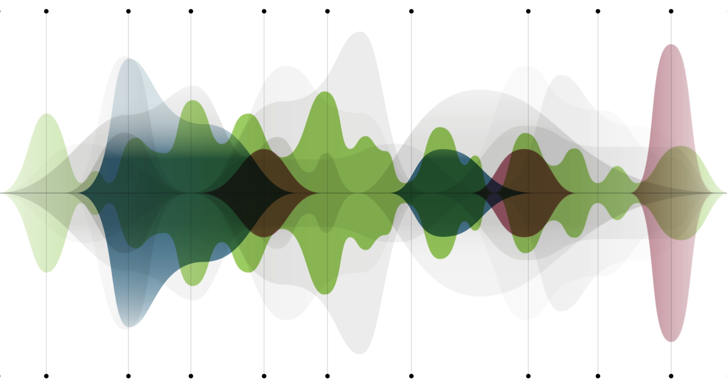



Automatic processing seamlessly adjusts
24
years of experience
in machine learning
using real-world sound recordings
700
scans per
second
for real-time adjustment to the environment
Unique setting combinations
to meet the individual needs of patients
Breakfast
Commute
Office
Cafe
Work
Shopping
Bar
Streaming
Concert
Notes:
The first way we address the variety of environments you encounter is through our automatic processing. The system scans the environment 700 times a second and analyzes to respond and adapt with unique setting combinations for that specific moment in time.
What does that mean for you? It means that the hearing aids can seamlessly adjust to the listening environments that you are in. And it does it automatically for you—put them on and forget about them.

Slide 21

Advanced features provide benefits for fatigue, memory, and comprehension
21%
less fatigue at the
end of the day¹
Improved memory
and comprehension performance¹
*Speech Enhancer on versus off
1. Latzel, M, Heeren, J and Lesimple, C. (2024) "Speech Enhancer reduces listening effort and fatigue." Phonak Field Study News retrieved from www.phonak.com/evidence
Notes:
We know that most of us spend a good amount of the day in quiet situations around home or office. (From datalogging, clients spend at least 68% of their day in listening situations that are classified a Calm situations.)
Think about the challenges in these environments—maybe it’s a soft-spoken spouse or grandchildren, or speech from more of a distance due to furniture configuration, someone you have to strain to hear. One advanced feature is proven to help with these soft voices in quiet. We know from the research that Speech Enhancer has been shown to lead to improved speech intelligibility, less listening effort and higher memory-and comprehension performance.
What could you do with your day because of being less fatigued? Would you go to that social event because you don’t feel so tired? Would you be more likely to join conversation? Or maybe simply enjoy not being as worn down by the end of the day from working so hard to hear. These are possibilities, and equally we could say that this could have a very positive impact on well being.
*Speech Enhancer on versus off
1. Latzel, M, Heeren, J and Lesimple, C. (2024) "Speech Enhancer reduces listening effort and fatigue." Phonak Field Study News retrieved from www.phonak.com/evidence

Slide 22
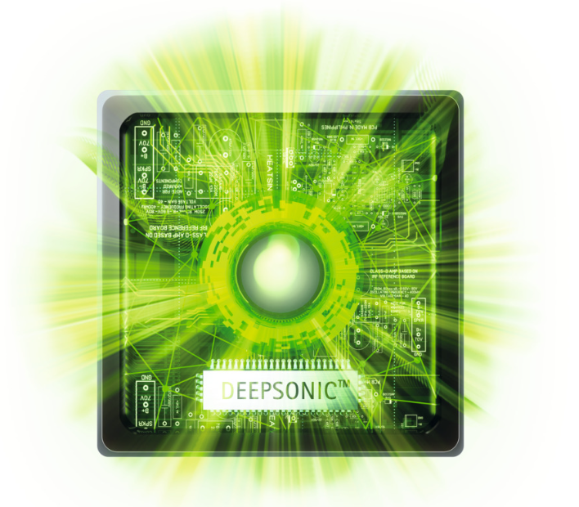


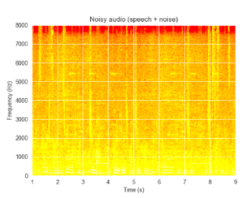
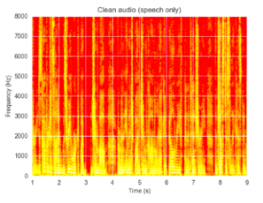
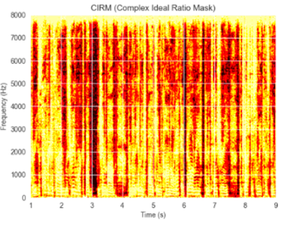
Exciting innovations help in noisy places
Before
After
Noisy audio (speech + noise)
Separate speech and noise
Clean audio (speech only)
Notes:
We know that most of us struggle to hear in background noise, as well. We now have hearing aids that revolutionize hearing in these challenging environments. For the first time ever, we have hearing aids with an additional dedicated sound processing chip that specifically uses sophisticated artificial intelligence (AI) to analyze and filter out the background noise like never before! This is a world’s first that is very exciting!
These are just a couple of features we have available to help you meet your hearing goals.

Slide 23
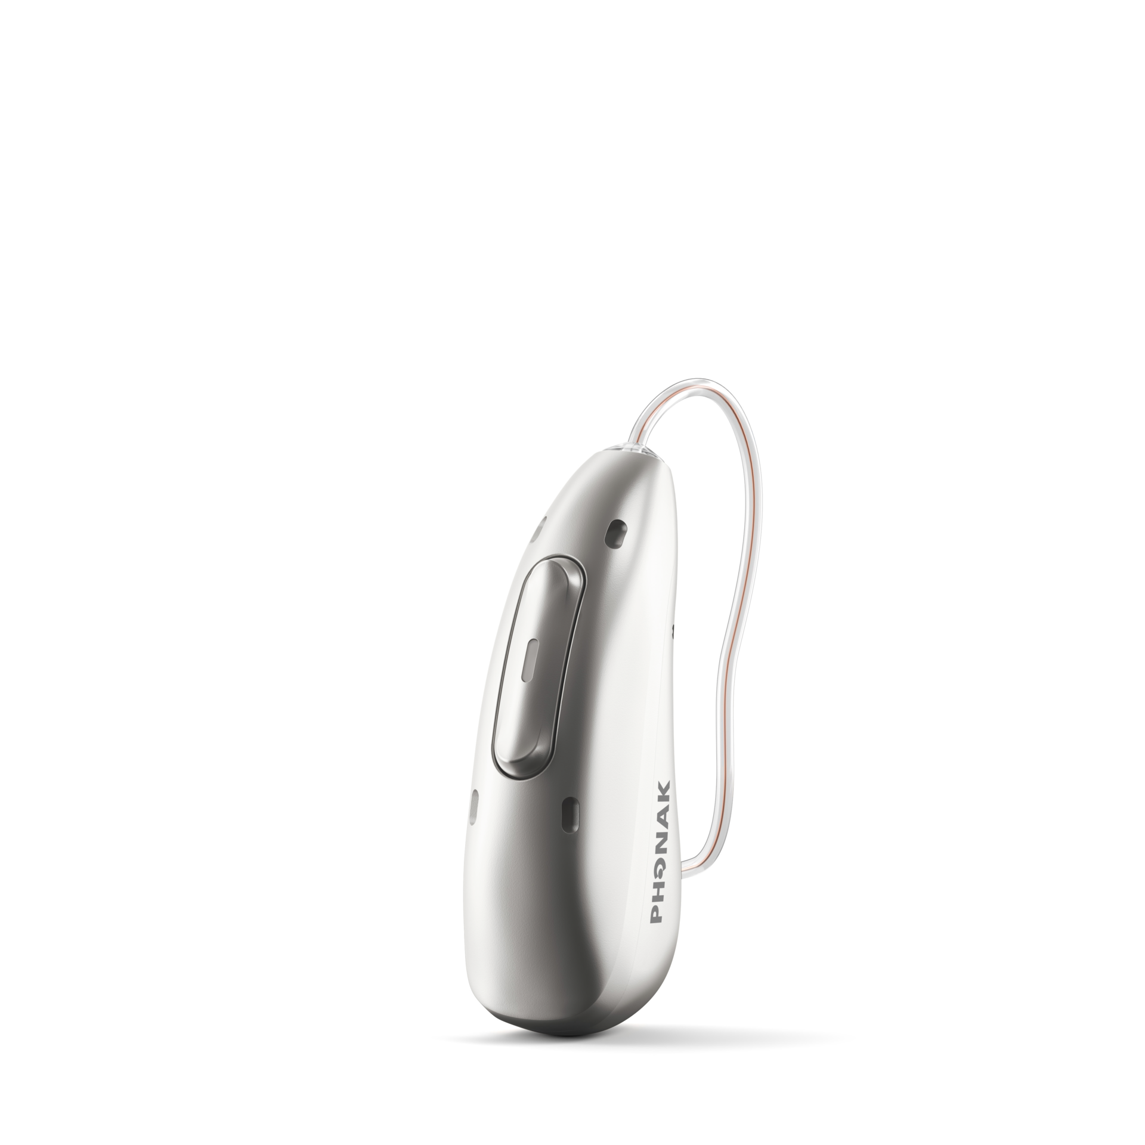
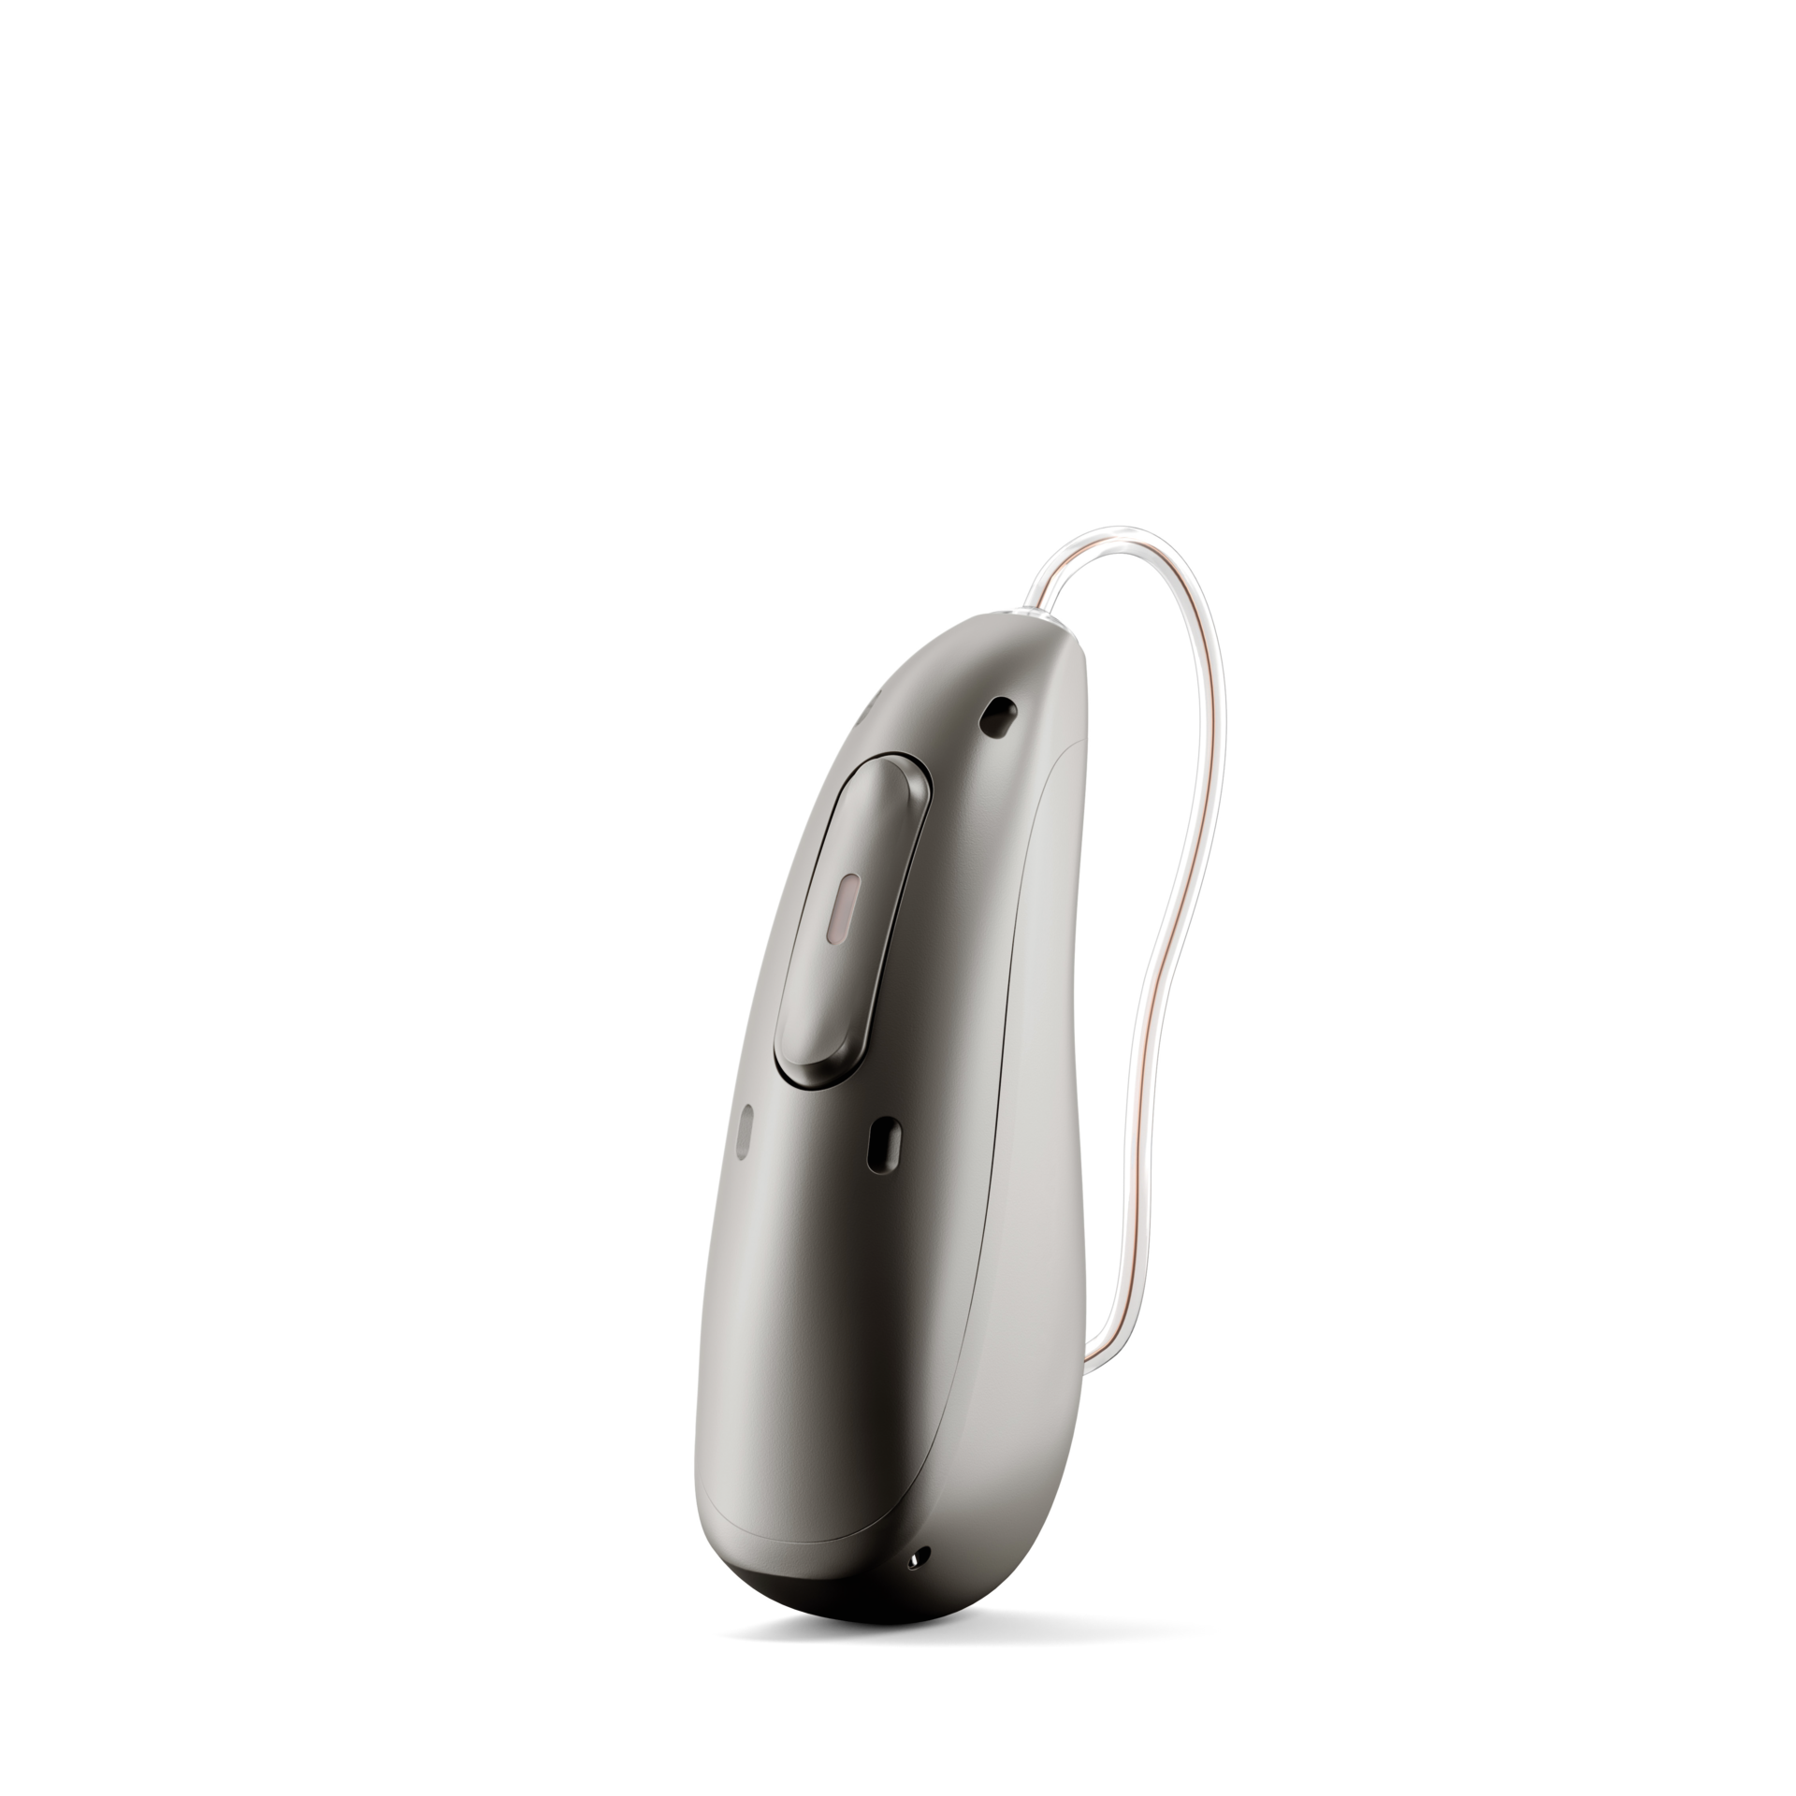
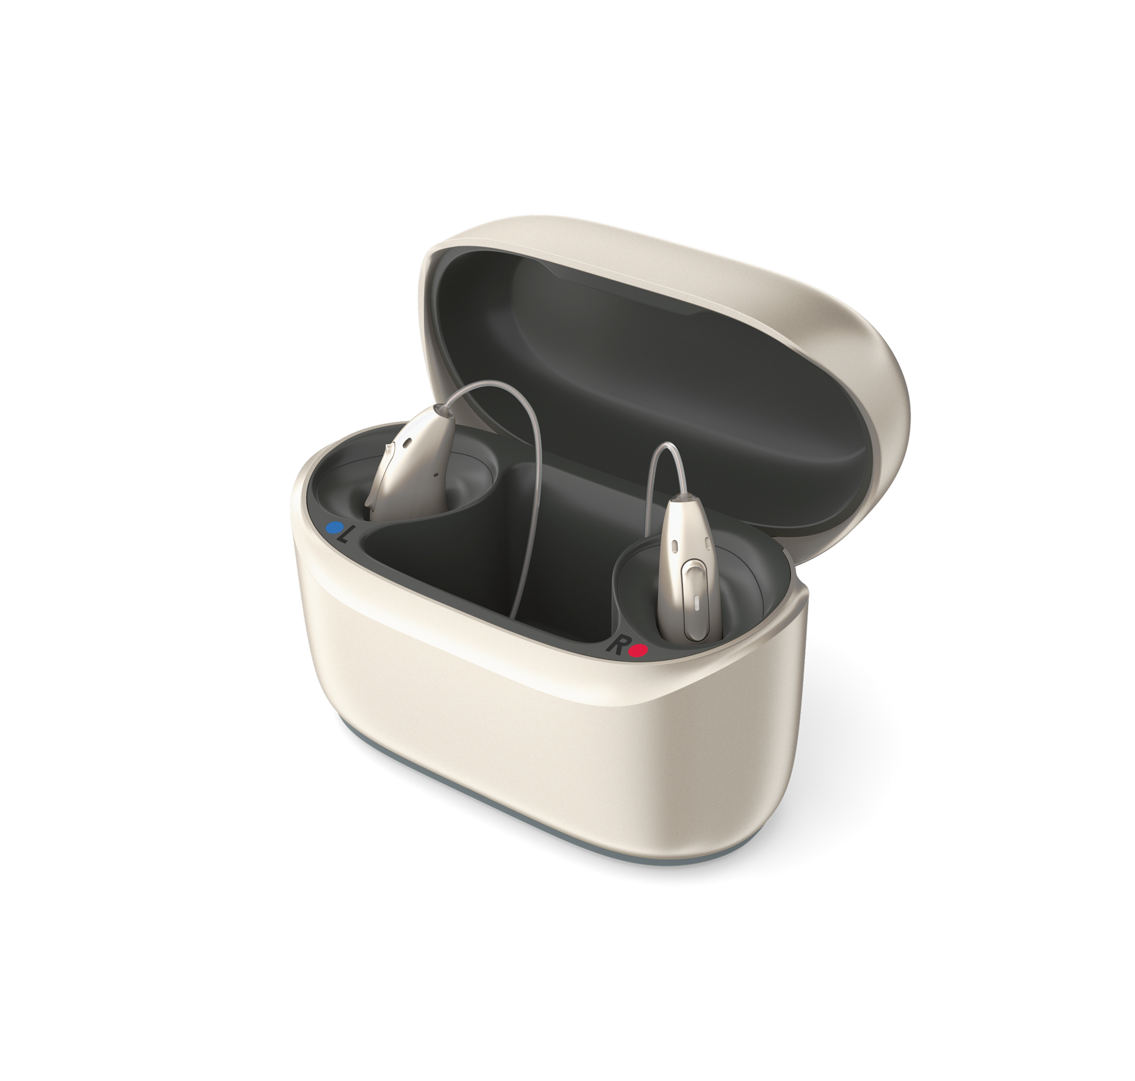
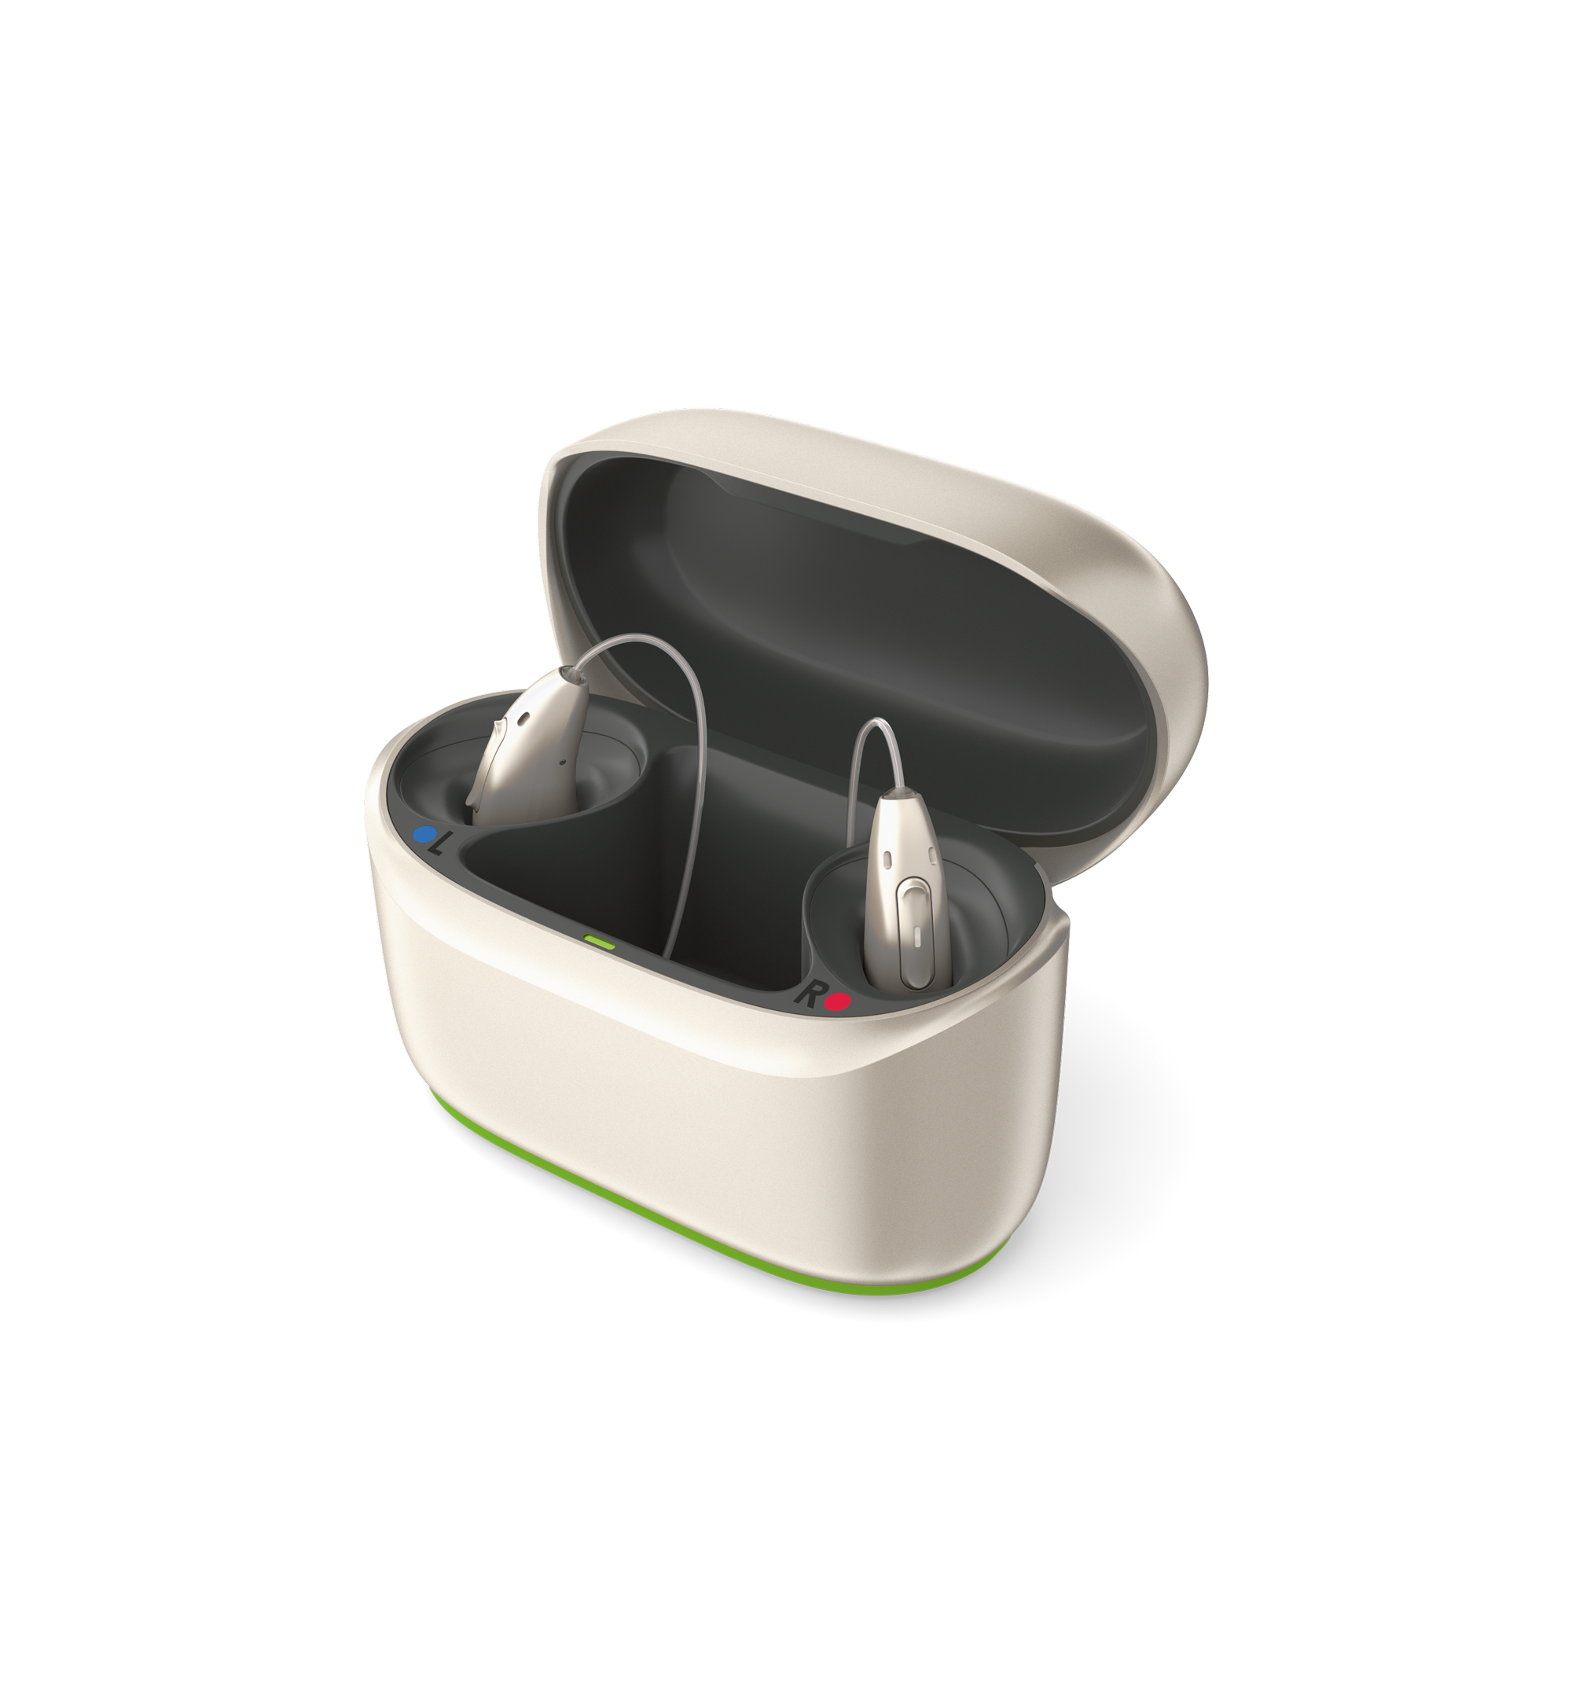
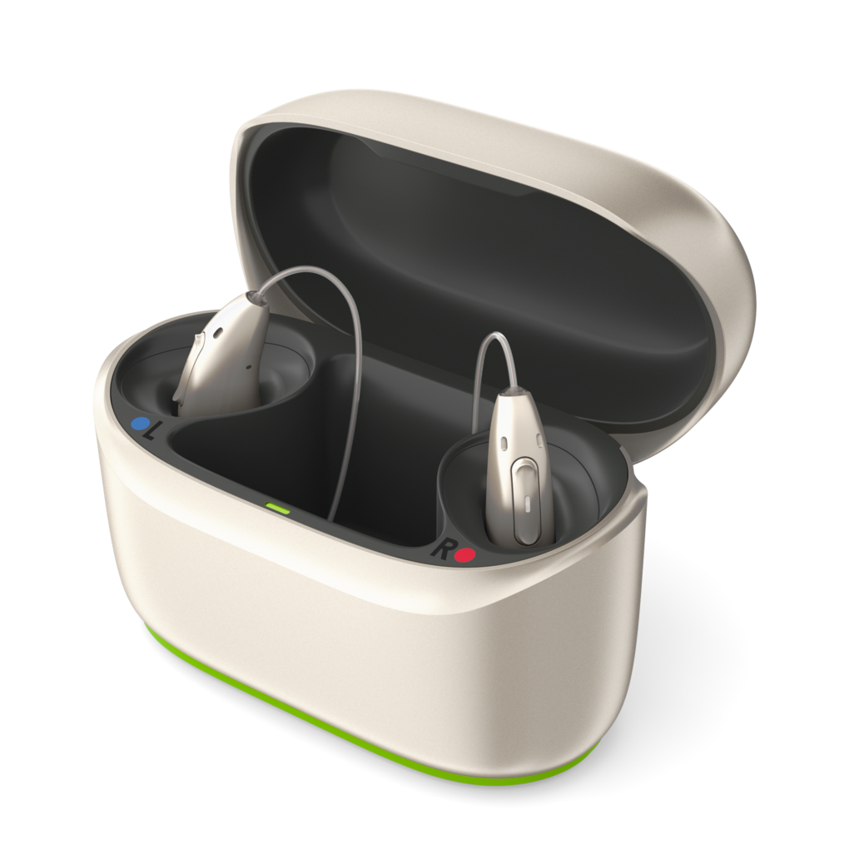
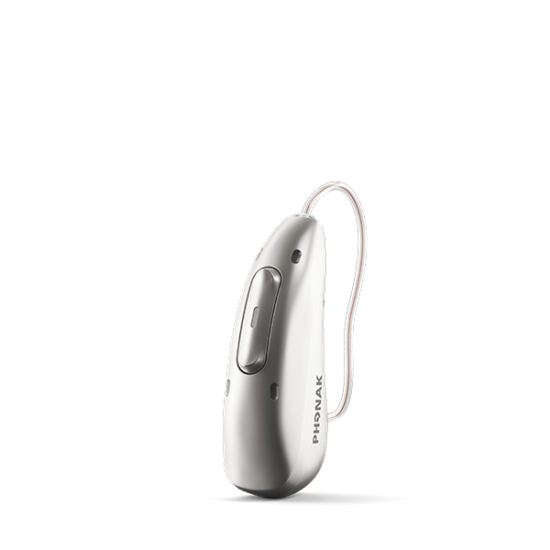
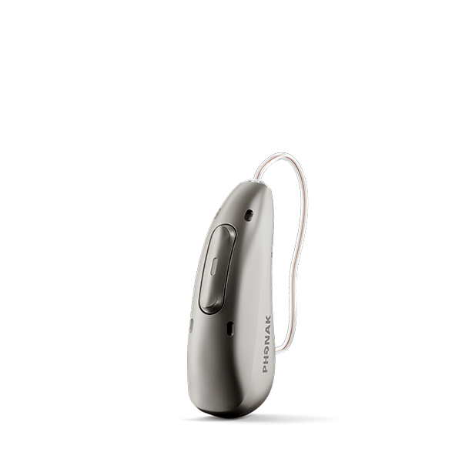
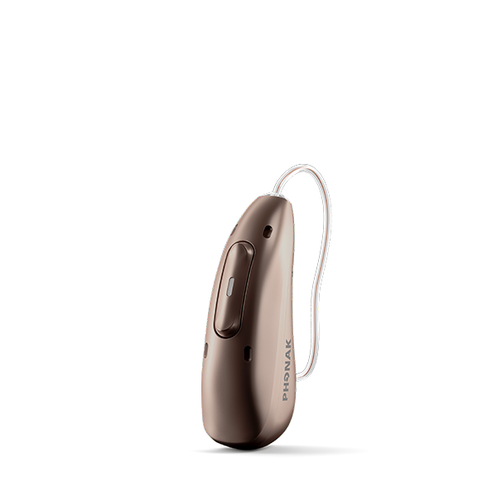
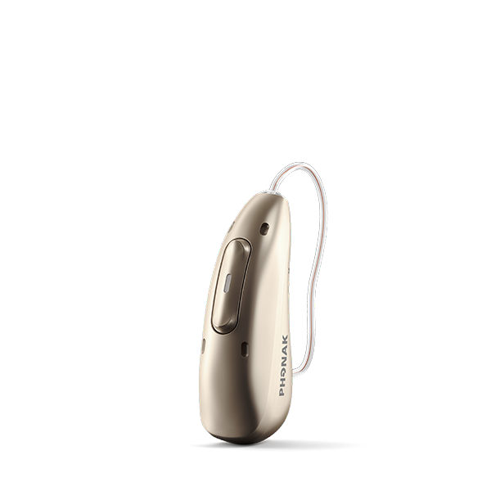
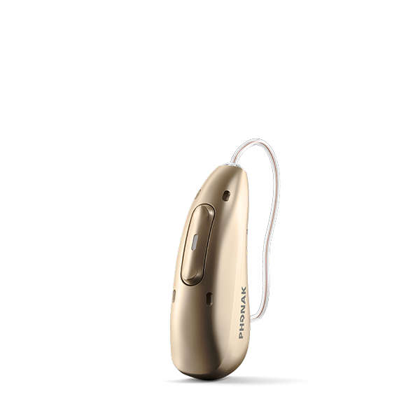
Phonak Audeo Infinio
Phonak Charger RIC Infinio
Phonak ChargerGo RIC Infinio
Phonak ChargerGo RIC Infinio
Audéo I-R
Audéo I-Sphere
Silver Gray
Graphite Gray
Chestnut
Champagne
Sand Beige
Notes:
Audeo Infinio is a receiver-in-the-canal style of hearing aid. The hearing aid sits behind your ear with a nearly invisible wire that runs down to your ear canal for the speaker to sit in.
​
The Audeo Infinio portfolio includes Audeo Infinio Rechargeable and the Audeo Infinio Sphere that has that exciting new feature we just talked about.
​
You’ll notice all these models are rechargeable – you’ll no longer need to worry about replacing batteries or having batteries die in the middle of your day. These will last you all day long, and will recharge overnight while you sleep. ​
​
They also come in 10 different colors to help match your desired level of discretion or style. ​
​

Slide 24
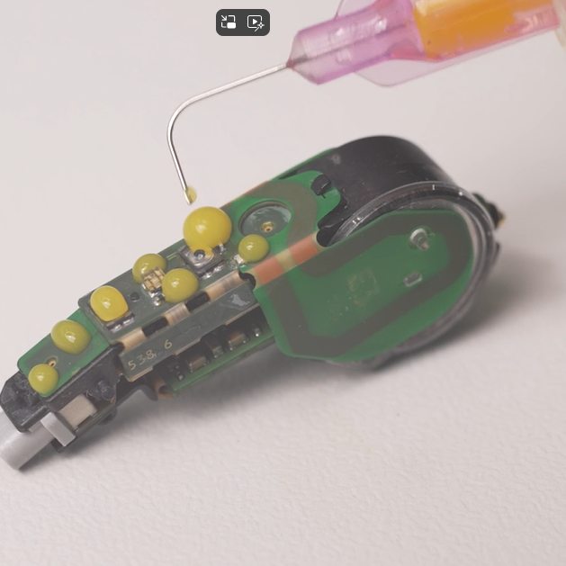
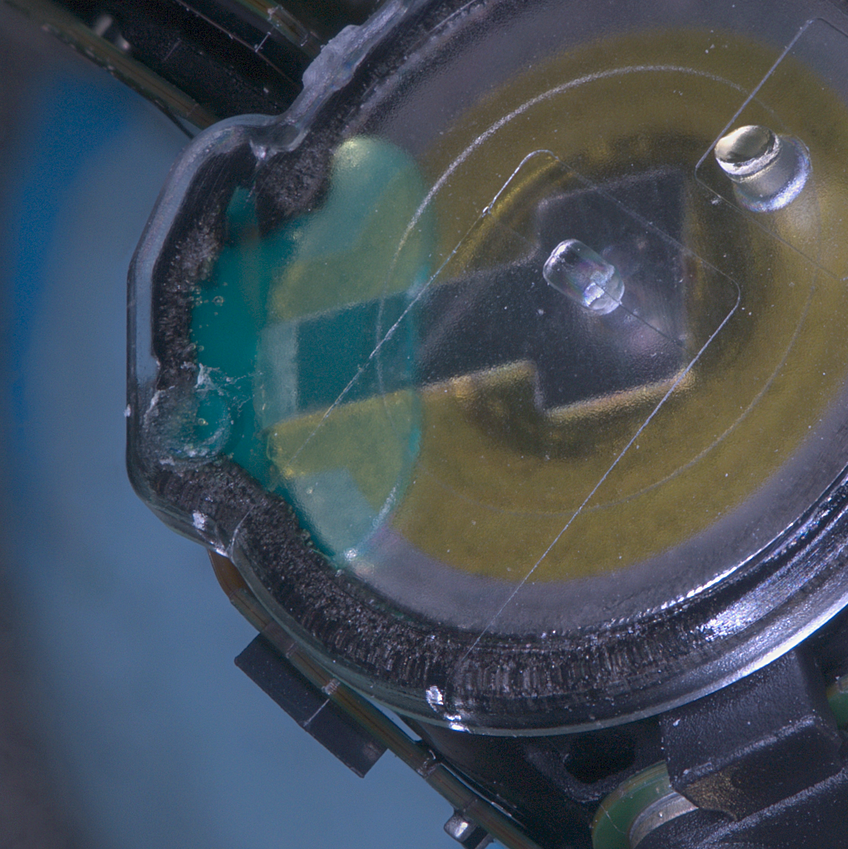
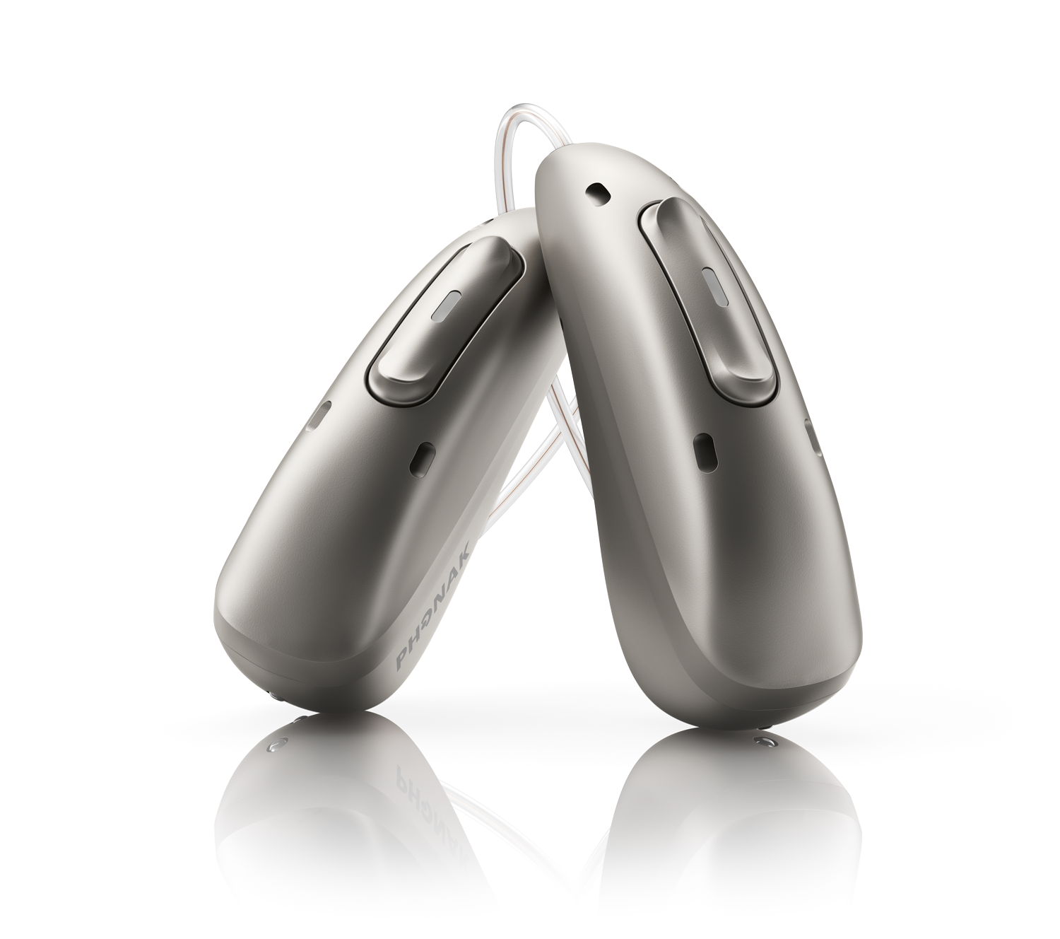
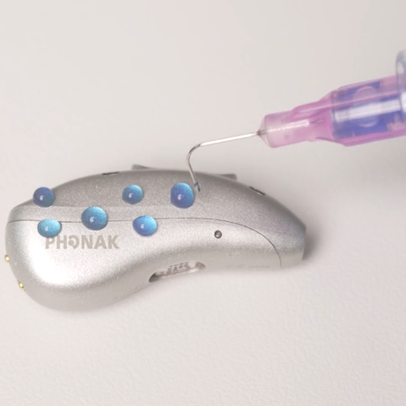
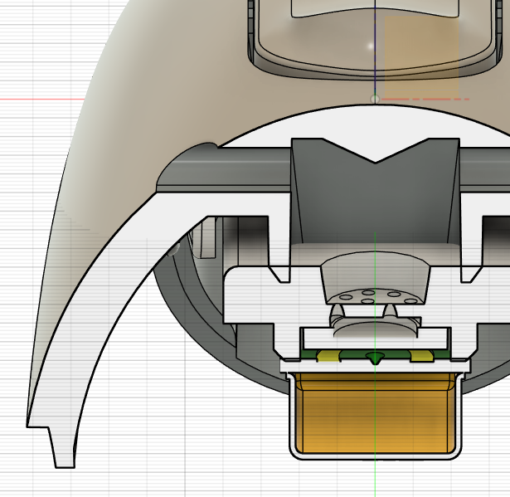
Our design. Ready for rain, ready for dust, ready for life.
Parylene-coated internal circuitry
Fully encapsulated battery
Improved microphone protection
Protected housing
Notes:
The 3rd generation of protection with water resistant and sweatproof technology is now a standard offer across the whole Phonak Audéo Infinio range
Protection make your Audéo Infinio hearing aids ready for rain, ready for dust, ready for life.

Slide 25



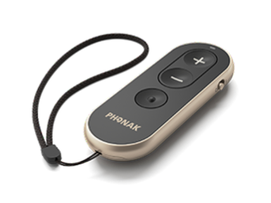

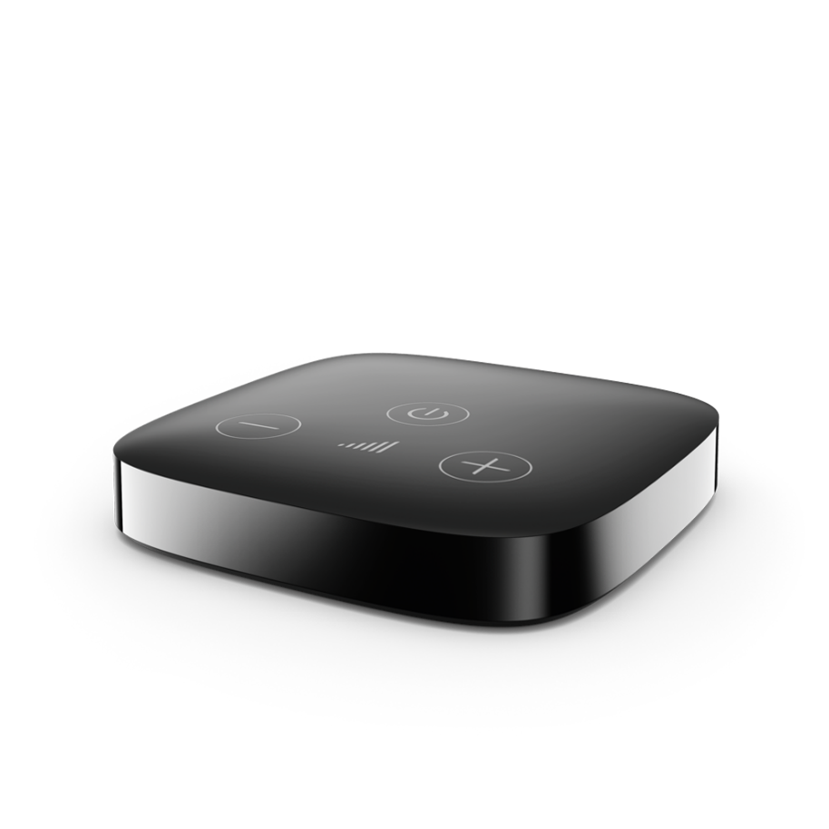
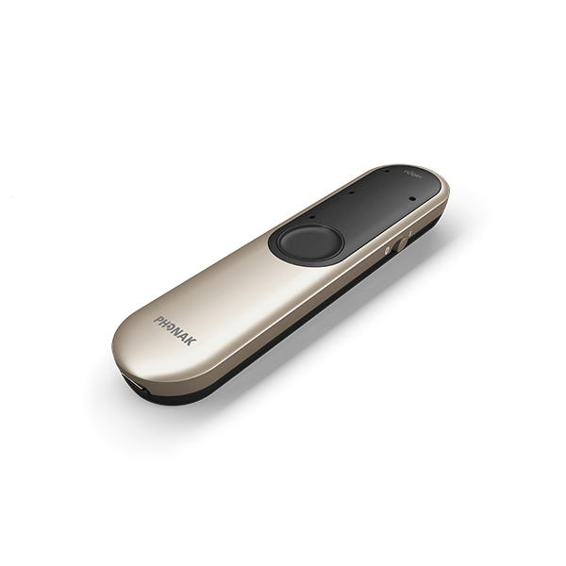
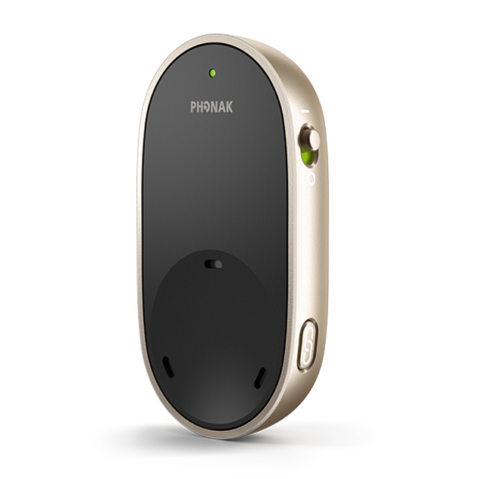
Accessories and apps extend the function of aids
User control & personalization
Streaming
media
myPhonak app
myPhonak
Junior app
RemoteControl
Over distance & in noise
Roger On
TV Connector
PartnerMic
Notes:
Accessories and smartphone apps can provide additional functionality and control. When we meet, we will discuss your situations and which of these might best fit your situations.

Slide 26
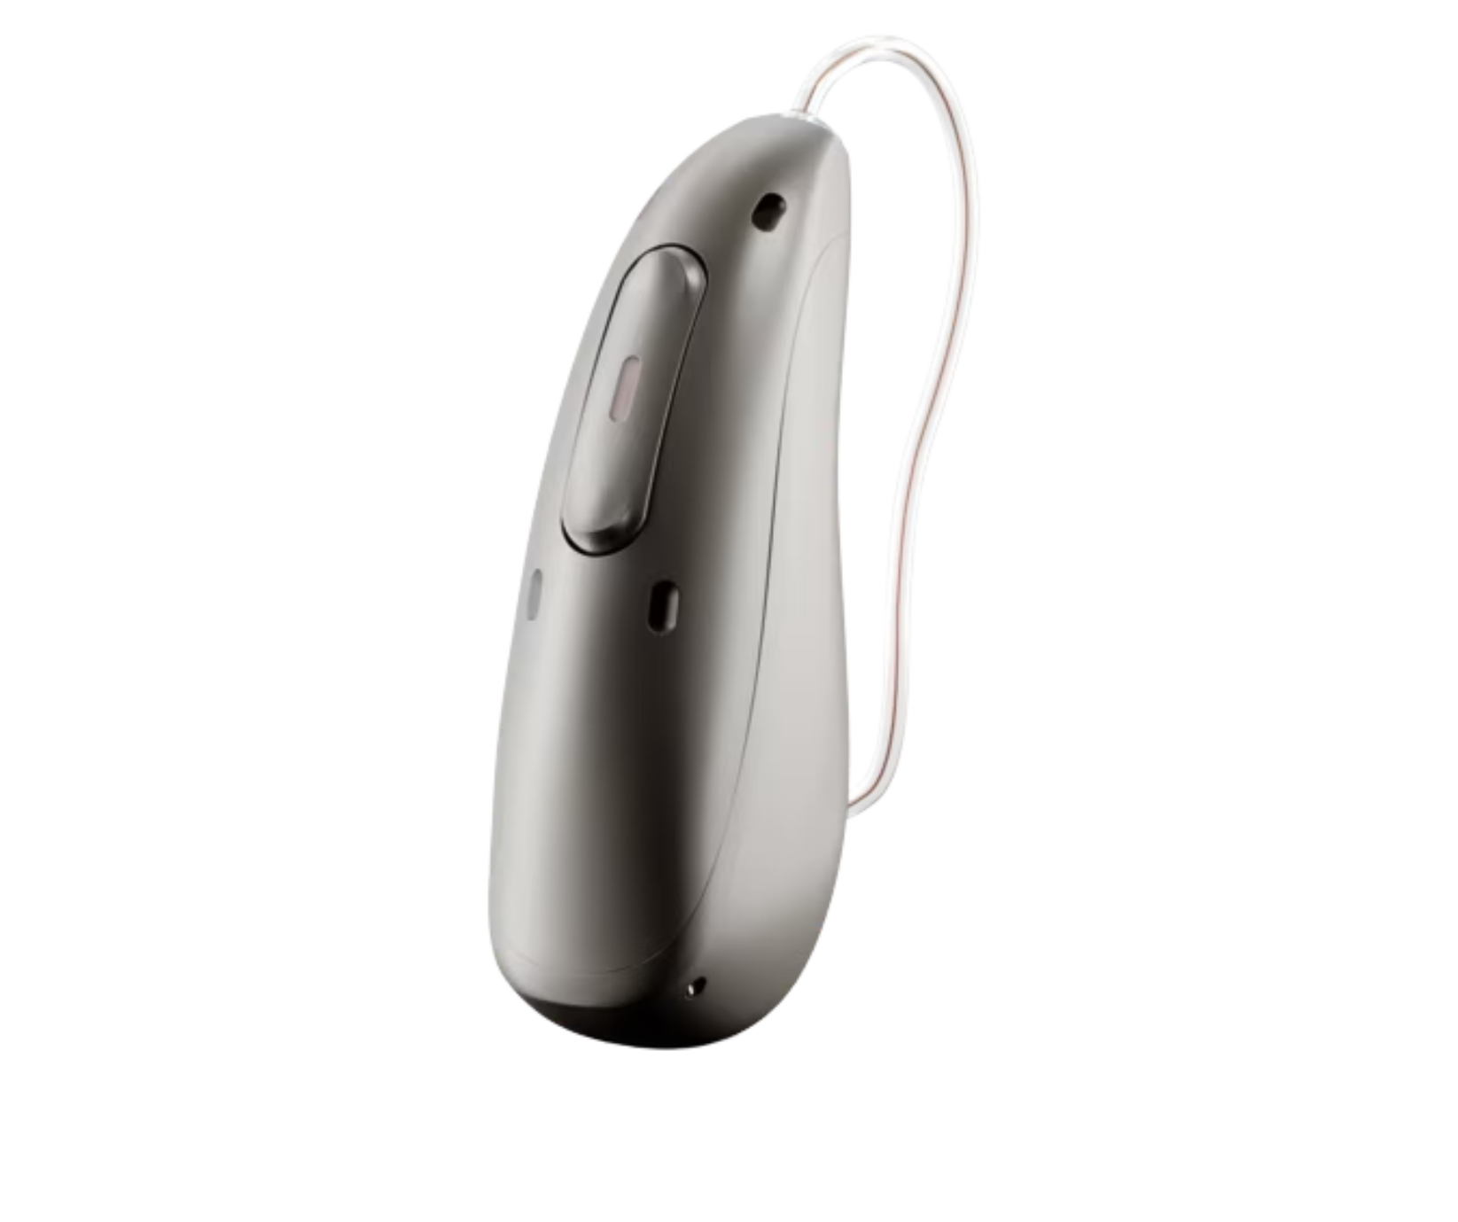
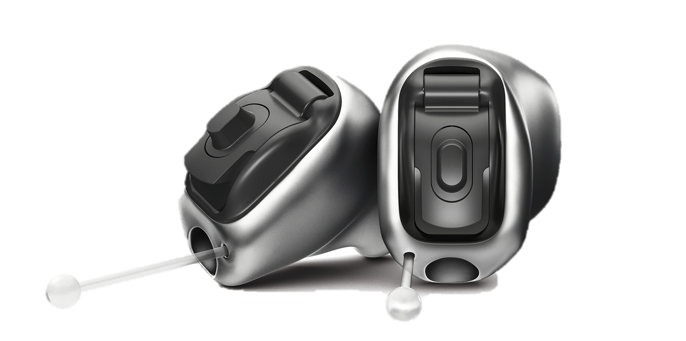
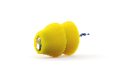

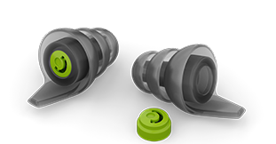
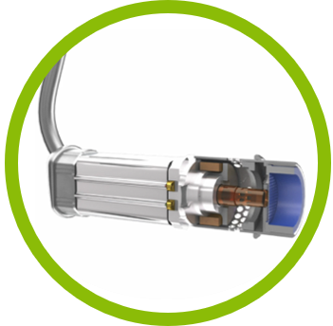
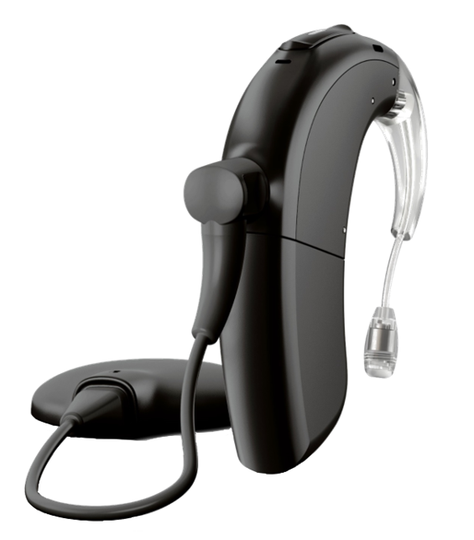
Solutions for every need
Proven durability for dust and moisture
Personalized fit
Health tracking
24/7 invisible
Sleek and Slim
Hearing protection
Bimodal solutions
Dynamic venting
Hearing in noise and over distance
Severe-to-profound hearing loss
Unilateral hearing loss
Pediatrics
Notes:
We’ve highlighted one family and type of products, but there are others.
Because no two people are exactly alike, there are solutions for every need.
You don’t have to now about each of these options—that is my job. Together we discuss what style of hearing instrument is right for you, what features need to be part of your solution, and what success looks like so we can get you there.
We have hearing aids that are :
Bluetooth compatible regardless of your phone
Able to be connected to your technology so you can stream music or movies or phone calls
Designed and tested for dust and moisture so you can live your life without even thinking about your hearing aids
Rechargeable
Automatic
-Can discuss sophistication of current hearing aids compared to technology even 15 years ago.
-Can discuss your hearing eval/hearing aid eval process
-Can share patient success stories with different types of hearing aids or with hearing aids in-general

Slide 27
Key takeaways:
Your ears and your brain are equal partners
Hearing health is linked to brain health
Hearing aids can be protective of cognitive health
You play an important role in protecting your cognitive health
What difference would hearing better make in your life?
Notes:
In summary, we’ve reviewed how your brain and your ears are equal partners, and that when you hear better you can think better.
According to the newly published longitudinal studies we reviewed, hearing aids can be protective of your cognitive health, and
By wearing hearing aids, you not only play an important role in your cognitive health, but you have the power to potentially positively-affect your brain’s ability to think and remember.
We ended by highlighting a few hearing aid features that reduce listening effort and help as you go throughout your day.
Of course, (my team and) I would love to be your partner on this journey…

Slide 28
Thank you and next steps
Notes:
Add next steps for participants or any closing details.

