Slide 1

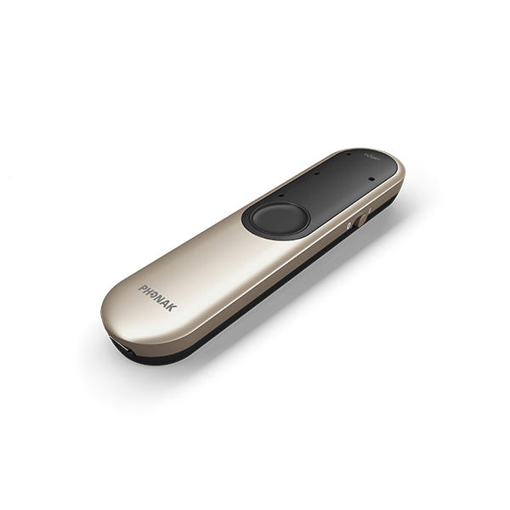
Complete the solution with Roger
Practice Name

Slide 2
Welcome
Introduce yourself to your audience
Include a short bio
Education
Years in practice
About your practice
Personal information such as hobbies and interests
And add picture(s) of yourself, your staff, family

Slide 3
Agenda
1.
2.
3.
Benefits of supporting hearing health
How Roger completes a hearing solution
Next steps
Notes:
During our time together today,
[CLICK] We will discuss the benefits of supporting hearing health.
[CLICK] We’ll introduce you to Roger and explain how that supports holistic hearing care.
[CLICK] We’ll end with next steps.

Slide 4
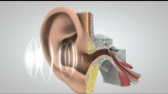
Notes:
How our senses work is amazing—as you’ll see in this video of how we hear.
(Segue from the end of the video where the brain understands to how the brain and the ears are equal partners.)
-------------------------
https://youtu.be/eQEaiZ2j9oc
Video is 2:27 long and you need internet to play the video.

Slide 5

The ears pick up
sounds
The brain comprehends
The better quality of the incoming signal the better chance for comprehension¹⁻²
1.Kiessling, J., Pichora-Fuller, M. K., Gatehouse, S., Stephens, D., Arlinger, S., Chisolm, T., . . . von Wedel, H. (2003). Candidature for and delivery of audiological services: special needs of older people. International Journal of Audiology, 42 Suppl 2, 2S92-101.
2.Pichora-Fuller, M. K. (2008). Audition and cognition: Where lab meets clinic. The ASHA Leader, 13(10), 14-17.
Notes:
As you saw, it’s not just your ears doing the work of hearing, listening and understanding, but it’s also your brain. And your ears and your brain are linked together.
Let’s talk about what I mean about the ears and the brain being equal partners.
Animations:
1. Just as we saw in the video, your ears pick up the acoustic signals (AKA sounds in your world)
2. The ear then decodes the information so it can travel to the brain and
the brain puts the sound puzzle together in a way that makes sense to the brain. (Have you misunderstood someone because of this problem here?)
Of course, The better the quality of the incoming signal, the better the chances for speech comprehension.¹⁻²
The better the cognitive resources, the better they can potentially compensate for missing information or hearing loss.
References:
Kiessling, J., Pichora-Fuller, M. K., Gatehouse, S., Stephens, D., Arlinger, S., Chisolm, T., . . . von Wedel, H. (2003). Candidature for and delivery of audiological services: special needs of older people. International Journal of Audiology, 42 Suppl 2, 2S92-101.
2. Pichora-Fuller, M. K. (2008). Audition and cognition: Where lab meets clinic. The ASHA Leader, 13(10), 14-17.

Slide 6

“Hearing better can help you think better.”¹
1.Blustein, J., Weinstein, B. E., & Chodosh, J. (2023). It is time to change our message about hearing loss and dementia. Journal of the American Geriatrics Society, 10.1111/jgs.18323. Advance online publication.
Notes:
There is growing evidence that addressing a hearing loss can have beneficial affects on overall well-being—including cognitive fitness.
By hearing better, you have more access to clear sound that your brain can process appropriately.
By hearing better, you allow yourself to be connected to your world and allows your brain to do things other than filling in the blanks or guessing what people are saying.
By hearing better, you can communicate better with everyone in your world. Socializing is a hugely important to your overall well-being, including your cognitive health.
Reference
Blustein, J., Weinstein, B. E., & Chodosh, J. (2023). It is time to change our message about hearing loss and dementia. Journal of the American Geriatrics Society, 10.1111/jgs.18323. Advance online publication. https://doi.org/10.1111/jgs.18323

Slide 7


A family affair
98%
of spouses
were affected by their partner’s hearing loss
Scarinci N, Worrall L, Hickson L. Factors associated with third-party disability in spouses of older people with hearing impairment. Ear Hear. 2012 Nov-Dec;33(6):698-708. doi: 10.1097/AUD.0b013e31825aab39. PMID: 22710661.
Notes:
We also know that hearing loss affects more than only the individual with the hearing loss, so seeking treatment can also have positive effects on friends and family-- fostering the connections between us.
---------------------------------
In a study by Scarinci** [of 100 spouses of older adults with hearing loss], 98% of spouses reported some degree of third party disability
Most spouses reported mild problems
Greater disability reported in the areas of
Emotional consequence (i.e. frustration)
Communication activities (i.e. reduced talking)
Everyday activities (i.e. TV viewing)
Scarinci N, Worrall L, Hickson L. Factors associated with third-party disability in spouses of older people with hearing impairment. Ear Hear. 2012 Nov-Dec;33(6):698-708. doi: 10.1097/AUD.0b013e31825aab39. PMID: 22710661.

Slide 8






Conversations happen everywhere
At home
In noise
In groups
At a distance
On the phone
Watching TV
Notes:
As a hearing care provider, I know that conversations happen everywhere: in quiet, in noise, on the go, over distance, while using technology.
My role is to be your partner in this hearing journey together. It’s important to determine your needs and hearing goals as well as those that come from your family members, friends, and communication partners.
I want to highlight a couple of the many benefits of modern hearing aid technology.

Slide 9
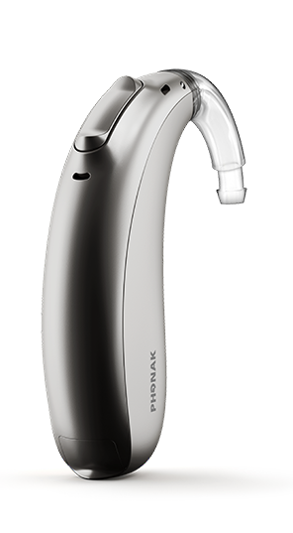
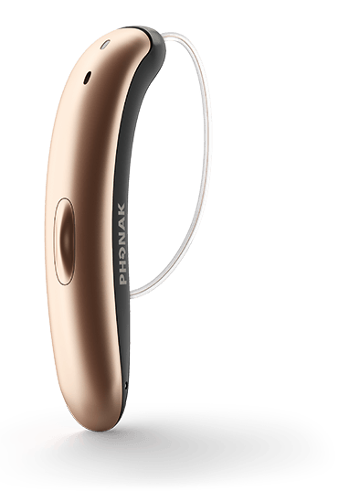
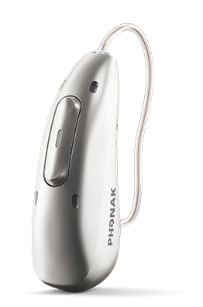
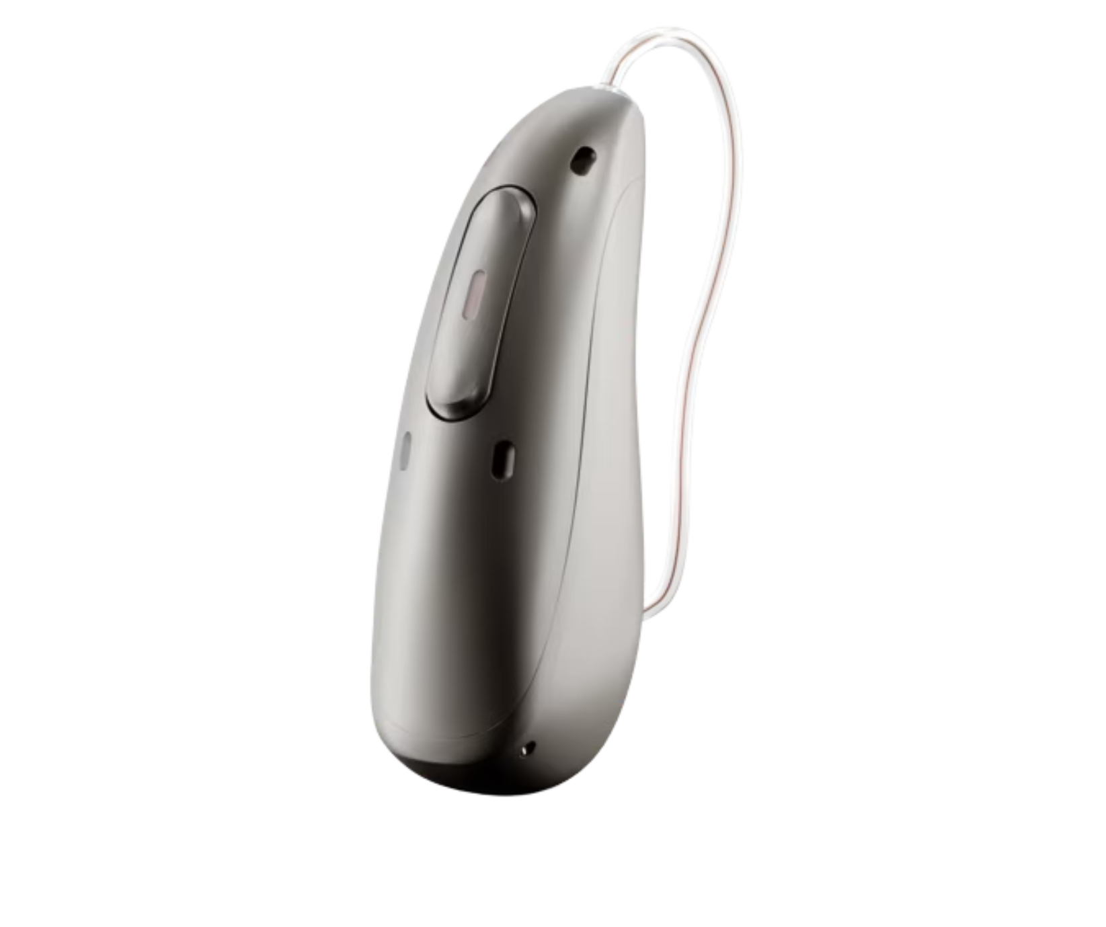
Hearing instruments are often the starting point
Automatic processing with exceptional sound quality
Compatible with phones, tablets, etc. for enhanced connectivity
Durable and reliable for peace of mind
Styles and colors to personalize your look
Notes:
This is an exciting time in the field of hearing health.
Hearing instruments utilize advanced processing to automatically adjust to your listening environments.
Special coatings and improved design makes instruments more durable for wherever life takes you.
Connections to phone and other devices are becoming ever-more important in this digital age.
As you can see, there are also a variety of styles and colors available.
All of these innovations have one goal—that you can enjoy the delight of hearing and live a life without limitation.

Slide 10
User satisfaction is high
83%
88%
Hearing aid owners satisfied with their hearing aids¹
Hearing aid owners reported having their expectations about hearing aids met²
Powers TA, Carr K. MarkeTrak 2022: Navigating the changing landscape of hearing healthcare. Hearing Review. 2022;29(5):12-17
Picou, E. M. (2020). MarkeTrak 10 (MT10) survey results demonstrate high satisfaction with and benefits from hearing aids. Seminars in Hearing, 41(1), 21-36. https://doi.org/10.1055/s-0040-1701243
Notes:
Currently satisfaction level of hearing aid users reflect that.
The needle of hearing aid satisfaction is moving forward positively.
Satisfaction with hearing instruments has increased to from 58% to 83% between 1989 to 2022¹.
When hearing aid owners' expectations are exceeded, they are more likely to be satisfied. Most hearing aid owners reported having their expectations about hearing aids met. Almost half (47%) reported their hearing aids were better than they had expected (either much better [22%] or somewhat better [25%]). Forty-one percent (41%) reported the hearing aid was about as expected,
With that being said, we know that there are situations that are still challenging.
1 Powers TA, Carr K. MarkeTrak 2022: Navigating the changing landscape of hearing healthcare. Hearing Review. 2022;29(5):12-17 (Note: MarkeTrak started in 1989)
2 Picou, E. M. (2020). MarkeTrak 10 (MT10) survey results demonstrate high satisfaction with and benefits from hearing aids. Seminars in Hearing, 41(1), 21-36. https://doi.org/10.1055/s-0040-1701243

Slide 11
What are situations where you’d like to do even better?
Notes:
What are situations where you’d like to do even better? What would that mean to you if you could __________?
--------------------------
Do you experience any of the following:
Lead an active lifestyle and experience challenges in situations involving noise and distance
Withdrawing from social situations
Would like increased clarity with TV, telephone or other technology
Still struggle to understand and communicate in challenging situations

Slide 12

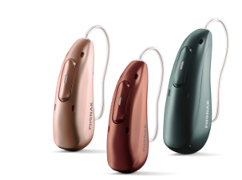
Even hearing instruments can use some help
StereoZoom 2.0 /
Spheric Speech Clarity
Noisy
Noise level
Directional microphones
Omni microphone
Quiet
Face to face
At distance beyond 5 ft.
Distance
Notes:
It’s no surprise that people with hearing loss often report that they experience significant difficulties listening in noisy environments even when fit with hearing aids with sophisticated noise reducing features.
What’s important to know is that hearing aids provide the most benefit when the conversation partner is within 5 feet of the listener (aka you!) When noise is added into the environment, the hearing aid will apply directional microphone technology to help increase the voice of the person speaking and reduce the background noise – making it easier for you to hear those around you and be apart of the conversation.
[CLICK] As soon as the noise increases or the distance between the listener and speaker becomes greater, additional microphones like Roger, are needed to maintain speech intelligibility and understanding while overcoming both distance and noise.
When hearing gets tough in challenging listening situations such as in noise, over distance or in reverberant acoustic environments, Roger is the solution.
*Thibodeau L. M. (2020). Benefits in Speech Recognition in Noise with Remote Wireless Microphones in Group Settings. Journal of the American Academy of Audiology, 31(6), 404–411. https://doi.org/10.3766/jaaa.19060.

Slide 13

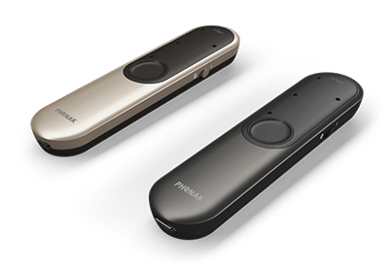
What is Roger?
Hearing
Performance
Ease
of use
Designed for versatility
Notes:
Roger is a remote microphone technology—that means it partners with the hearing instruments and is used to hear someone at more of a distance. Roger does that and so much more.
The name comes from the term ROGER in radio communications—Received Order Given, Expect Results. It’s not just about hearing there’s a voice, but hearing it well enough to understand and act.
Roger provides unrivaled hearing performance, ease of use, and is designed for versatility.

Slide 14
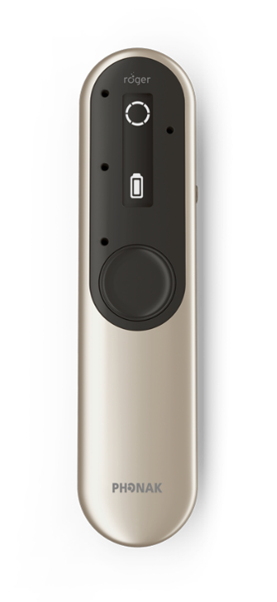
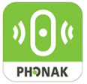
Flexible options for mic mode activation
Automatic changes based on position
Optional myRogerMic app
Beamforming selection
Push button control for manual changes
Notes:
Roger is Easy! It will adapt, based on how you hold it, to different microphone modes. Optionally, you can also use the push button or app to make changes.
Let’s take a look at a few ways you can use Roger.

Slide 15
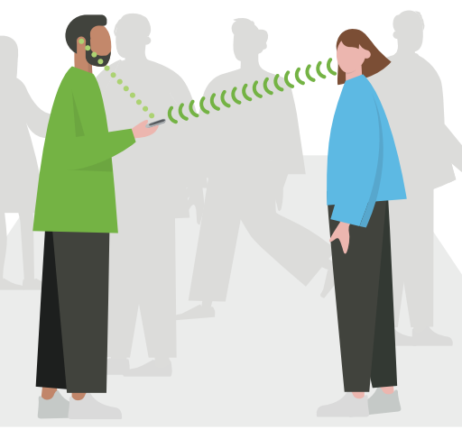
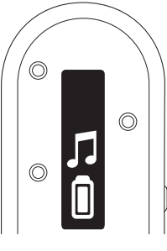
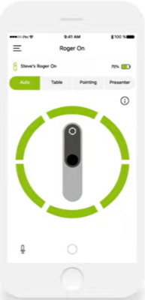
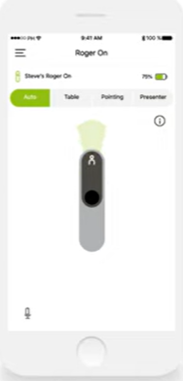
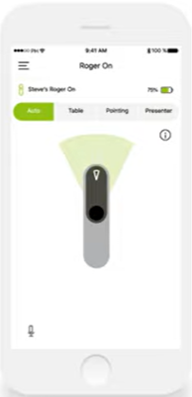
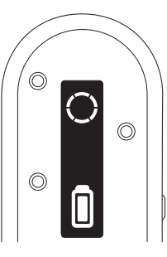
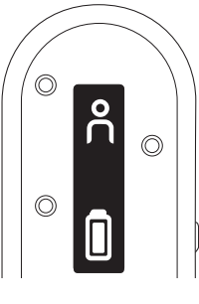
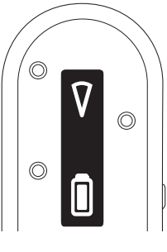
Table Mode
Presenter Mode
Pointing Mode
Streaming
And more!
Notes:
(For demoing or discussion)
[CLICK] Table mode: dinner, card games
[CLICK] Presenter mode: date night, one-on-one, lectures
[CLICK] Point mode: medical appointments, cashiers, happy hour
[CLICK] Streaming: TV
And more! (headset mode & wide pointing mode[via the myRogerMic app])

Slide 16
Outstanding performance in noise and over distance¹
X
Hearing aid users understand almost
90%
10 times
better with Roger technology in noise and over distance than people with normal hearing.¹
of current Roger users would
recommend a Roger microphone to their friends and family.²
1 Thibodeau, L. (2014). Comparison of speech recognition with adaptive digital and FM wireless technology by listeners who use hearing aids. American Journal of Audiology, 23(2), 201-210.
2 Taphuntsang, D. (2019). Market Research ID 1299. Please contact marketinsight@phonak.com if you are interested in further information.
Notes:
Roger boosts hearing performance in noise and over distance. It is able to analyze the noise level and increase the signal to keep the voice above the noise.
This provides outstanding hearing performance in even more listening situations and offers you a complete hearing solution from the very beginning.
Roger provides up to 10 times better speech understanding in noise and over distance than people with normal hearing
90% of Roger users would recommend it to their friends and family
1 Thibodeau, L. (2014). Comparison of speech recognition with adaptive digital and FM wireless technology by listeners who use hearing aids. American Journal of Audiology, 23(2), 201-210.
2 Taphuntsang, D. (2019). Market Research ID 1299. Please contact marketinsight@phonak.com if you are interested in further information.

Slide 17

Users prefer Roger systems
100%
of the test participants preferred using a Roger system* compared with hearing aids alone.¹
* Roger system= Roger NeckLoop and Roger Table Mic II.
FSN reference to come ”Speech improvement using Roger NeckLoop with different brands of hearing aids”.
Notes:
And when given the opportunity to use a complete hearing solution including Roger, patient’s preferred the listening situations when they were using Roger as compared to not using Roger.
In fact – one of the patients in the study said: “Why would I choose to hear less!?”

Slide 18
Key takeaways:
Your ears and your brain are equal partners
Hearing health is linked to brain health
Hearing instruments helps in a variety of situations
Roger technology provides additional help in noise and over distance
What difference would hearing better make in your life?
Notes:
In summary, we’ve reviewed how your brain and your ears are equal partners, and that when you hear better you can think better.
Addressing hearing loss with hearing instruments is an important first step and many of today’s aids have features to help in a variety of situations.
For those situations that need extra help, Roger rounds out the hearing solution and can provide additional benefit.
Of course, (my team and) I would love to be your partner on this journey…

Slide 19
Listen to Roger & schedule your solution consultation today
Thank you
Notes:
next steps for participants or any closing details.

